Slide 1
Capstone Project Data Analytics
By: Christian Cajamarca

Slide 2
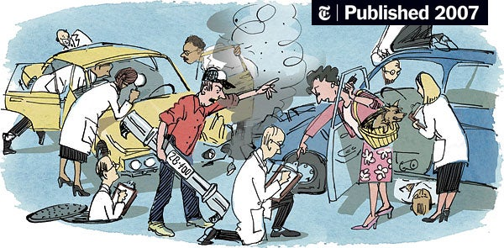
Motor Vehicle Collisions-Crashes NYC
Overview
Get a better understanding of NYC-Queens motor vehicle collision data.
Compare NYC Boroughs Motor Vehicle Collisions
Top Queens zip codes with the most Motor Vehicle
Crashes in the past 10 years (2012-2022)
View Queens map with top 10 zip codes with the most Motor vehicle crashes
- Not so fun findings

Slide 3
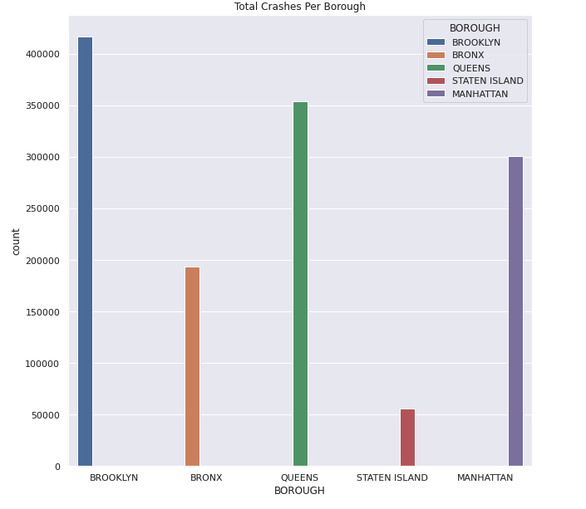
NYC Boroughs Car Crash Data
Combined data set from 2012-2022
Brooklyn is the borough with most car accidents ~ 425,000
Averaging 42,500 crashes a year
Staten Island has a little over 50,000 car crashes in the past 10 years
Averaging 5,000 crashes a year

Slide 4
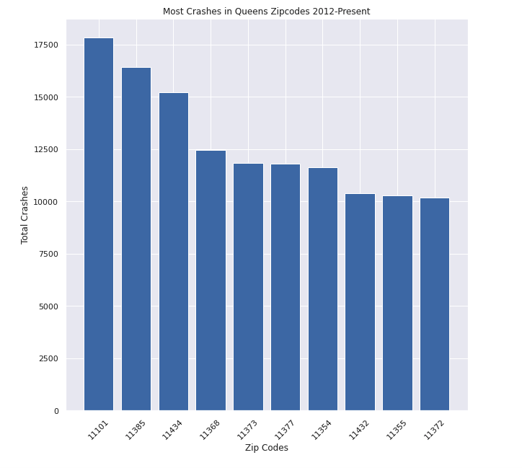
Queens – Top 10 Zip codes with most crashes
Total car crashes in the past 10 years ~ 350,000
Averaging ~35,000 crashes per year
Top zip code with most crashes- 11101- Long Island City
The police report (MV104-AN) is required to be filled out for collisions where someone is injured or killed, or where there is at least $1000 worth of damage

Slide 5
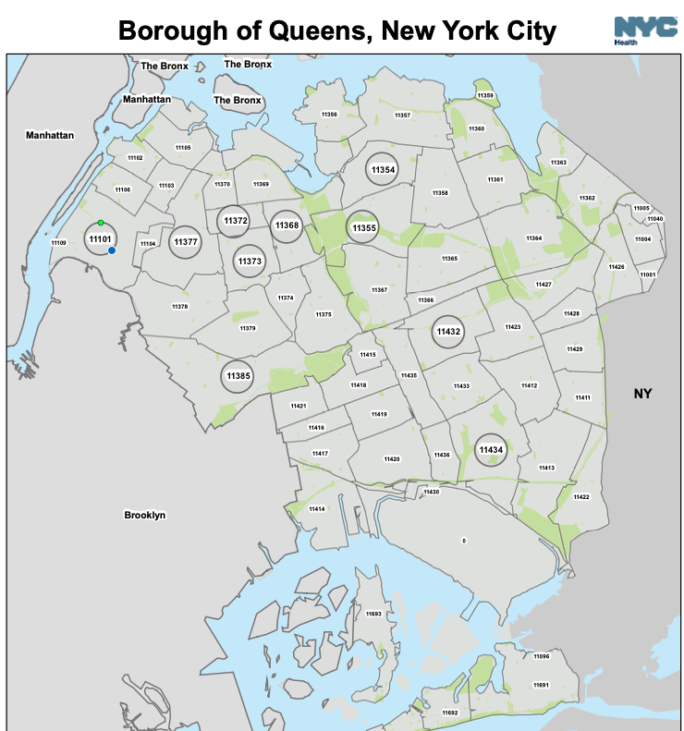
Queens Map with data

Slide 6
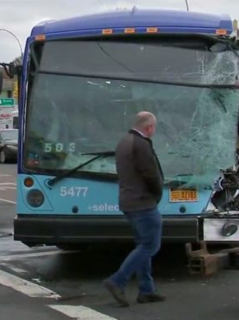
Not So Fun Findings
Exploring Queens crashes
Multiple motor vehicle crashes with 15+ people getting injured
Zip code: 11427, On Street: Hillside Avenue, Cross Street: Hollis Court Boulevard
Number of Person Injured: 32
Crash Date 04/17/2015
No deaths
Majority of the major accidents involve a compact vehicle striking a bus.
Notes:
Zip Code- 11101, On Street- Northern Boulevard, Cross street- 42 street, # of persons injured – 22 , Crash date 06/08/2015
Zip Code – 11109 , On Street- 21 street, Cross Street- Ditmars Blvd, # of persons injured- 19
Zip Code- 11434, On street- Brewer Boulevard, Cross Street- 132 avenue, # of persons injured – 18
Excuses: Fatigue, Physical disability, disregarding traffic control, unsafe lane changes

Slide 7
Conclusion
Be careful when driving in Brooklyn
Watch out for busses

Slide 8
Citations
Data used
Queens Map Provided by NYC Health
Provided by Police Department (NYPD)
NYC Open Data
https://data.cityofnewyork.us/Public-Safety/Motor-Vehicle-Collisions-Crashes/h9gi-nx95

